Slide 1
Spring Planning Meeting Leslie Martinich Section Chair IEEE Central Texas Section January 21, 2017 San Marcos, Texas

Slide 2
Two Topics
Budget and how it is constructed
Planned Events for 2017 and beyond

Slide 3
Budget: Where does the Section get its Revenue?
Member Dues
Surplus from Conferences and Workshops
Other lesser sources
PACE (Professional Activities)
Region
Societies-> Chapters
Industry (none yet!)
Attendees’ fees at meetings

Slide 4
Members’ Dues
How does the money flow?
IEEE
Rebate to Section
Chapter Budgets

Slide 5
Surplus from Conferences and workshops
How does the money flow from Conferences and Workshops?
Section
Section & Chapter Travel Pool, Training, Coffee Cups, Awards & Dinner, Student Liaison, K-12 Support

Slide 6
What’s the Process?
October-November
Chapters construct budget plans for following year, submit to Treasurer
December
Treasurer and ExCom plan the budget for the following year, rolling up the Chapter Budgets
January
Budget is circulated to Chapter Chairs and is finalized at or after Spring Planning Meeting

Slide 7
How Hard is it to Construct the Chapter Budget Plan?
Rebate to Section
Starting point:
From the Rebate $ 200
Active Chapter Bonus $ 75
Revenue
From Society support, corporate support, etc
Expenses
For meetings, supplies
This is all about normal monthly meetings

Slide 8
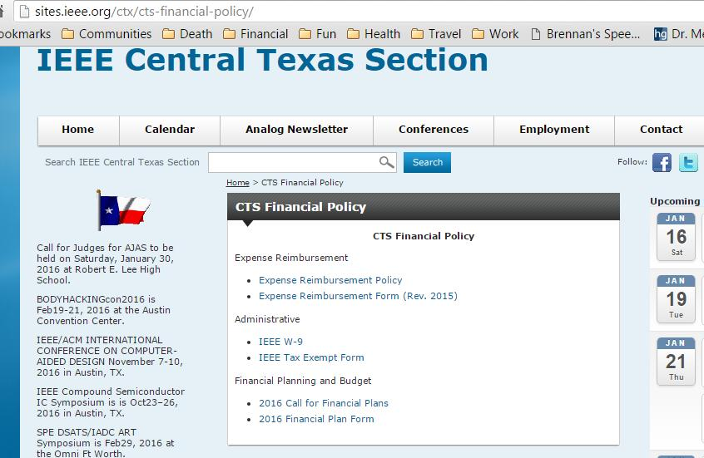
Where do I get these forms?

Slide 9
Things To Note
Planning a workshop or conference is separate, see
http://sites.ieee.org/ctx/conferences/
If you provide AWARDS worth more than $100, the recipient will have to fill out a form for IRS.

Slide 10
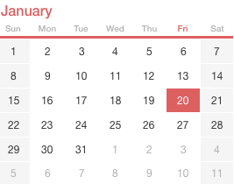
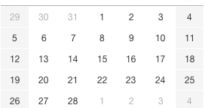
NEXT Topic: Upcoming Events
Engineers’ Week
IEEE/ACM International Symposium on Code Generation and Optimization

Slide 11
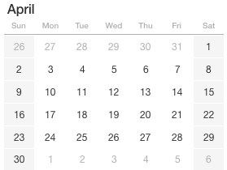
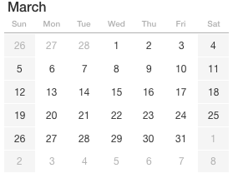
Upcoming Events
SxSW
Custom Integrated Circuits Conf.

Slide 12
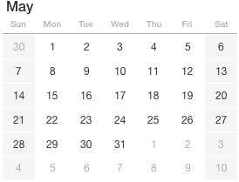
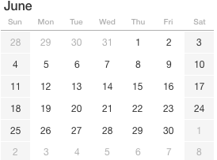
Upcoming Events
ICICDT
DAC

Slide 13
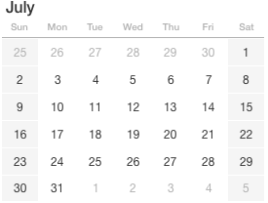
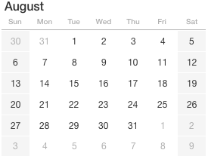
Upcoming Events
Future Leaders Forum

Slide 14
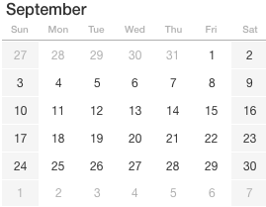
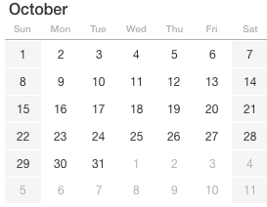
Upcoming Events
IEEE DAY
Accelerated Stress Testing & Reliability
ACM/IEEE 20th International Conference on Model Driven Engineering Languages and Systems (MODELS)

Slide 15
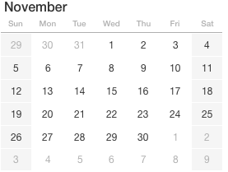
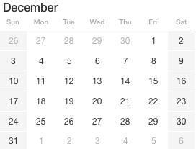
Upcoming Events

Slide 16
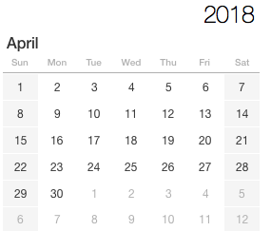
Upcoming Events
IEEE DAY
Green Tech/Clean Tech
R5 Meeting
Accelerated Stress Testing & Reliability

Slide 17
Questions?
Contact me
lmartinich@ieee.org
512.423.5121

